Slide 1
Session 3 Gospel of John Class January 26, 2020
Resurrection Lutheran Church, Cary
Jonathan A. Blanke, Ph.D.

Slide 2
“The Bridegroom”
John 2:1–13 & 3:28–30

Slide 3
“Signs” (σημεια)
The Cana miracle ends with the words, “This, the first of his signs, Jesus did in Cana” (2:11).
Miraculous actions of Jesus in other gospel accounts are called “miracles” (δυναμεις).
“Signs” by definition point to meaning beyond themselves; though signs in this gospel are a kind of symbolic action, they occur in the narrative of John as actual, historic events.
Signs included in John’s Gospel are included “so that you may believe that Jesus is the Christ, the Son of God, and that by believing you might have life in his name” (20:30-31).

Slide 4
What did/does the miraculous sign at Cana mean? (Part 1)
Conversations and discourses surrounding these symbolic actions help elucidate their meaning...
Call to mind our earlier discussion on dramatic irony (the readers know something hidden from people in the text or onstage). What do we the readers know about Jesus’ sign that someone in the text does not?
Identify misunderstanding in this text. Who “misunderstands” the sign? What does he misunderstand about it?

Slide 5
What did/does the miraculous sign at Cana mean? (Part 2)
Symbolic actions like the signs of Jesus appropriate and redefine associations with images connected with the sign or action
One important image from this text:
Bridegroom (in both Greco-Roman and Palestinian “Jewish” contexts, the bridegroom’s family paid for the wedding & its wine; see also Israel as the bride of God: Jeremiah 2:1-2; Isaiah 54:1–8, 62:5)

Slide 6
Excursus: “Friend of the Bridegroom” (3:29)
A friend of the bridegroom was charged with the preliminaries of the marriage. He arranged the contract, acted for the bridegroom during the betrothal, and arranged for, and presided over the festivities associated with the wedding itself.
Why do you suppose John called himself “friend of the bridegroom”?

Slide 7
What did/does the miraculous sign at Cana mean? (Part 3)
Allusions to Jesus’ death and resurrection appear in each of the symbolic actions, so that Jesus’ death and resurrection disclose the significance of earlier actions, and earlier actions help readers discern the meaning of Jesus’ suffering and death.
What connects this sign with the time of Jesus’ suffering, death, and resurrection (hint: read John 2:1-11 and then look up John 12:23, 27-28)?
Ωρα = “Time”/“Hour”

Slide 8
What did/does the miraculous sign at Cana mean? (Part 3)
Allusions to Jesus’ death and resurrection.
When Jesus says, “My hour/time has not yet come,” could he have been anticipating another outpouring of blood/wine at the Last Supper (John 13:1; cf. Matthew 26:27-28) more directly concerned with His status as Messiah who reveals the glory of God?
In Ephesians 5:25–33 we see how the death of Jesus was understood later as the moment of the Bridegroom preparing His bride (the Church) for her union with God (cf. Rev. 21:1-4)

Slide 9
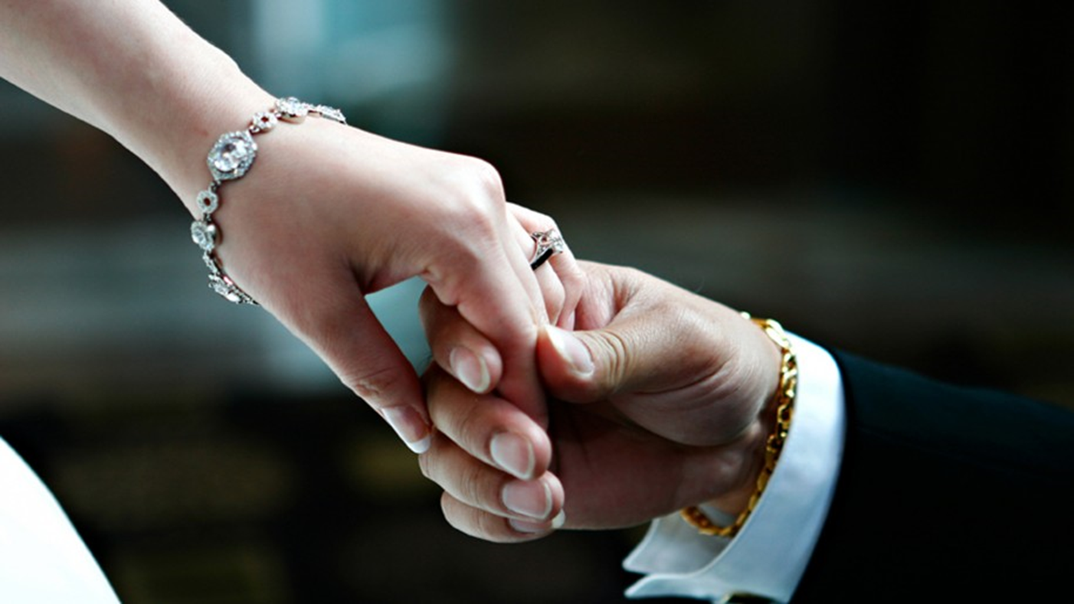
Discussion: Use of the Bridegroom Image Today
Do you think that the image of Jesus as bridegroom of the people of God still speaks to people today? Why or why not?
My story:
Conversation with a non-Christian
Bridegroom image and topic of “faithfulness” for those preparing to marry today

Slide 10
“Giver of Living Water”
John 4:1–30 & 7:37–39

Slide 11
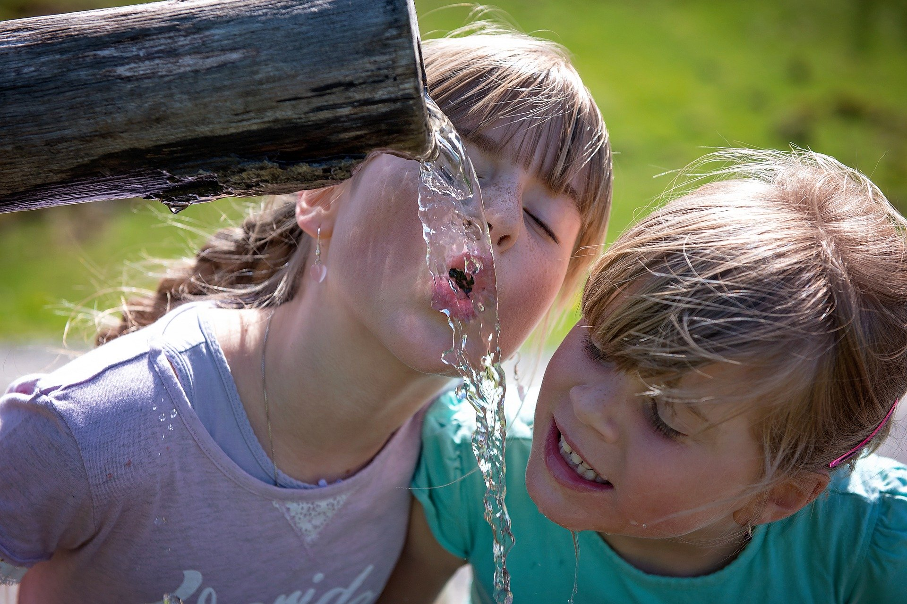
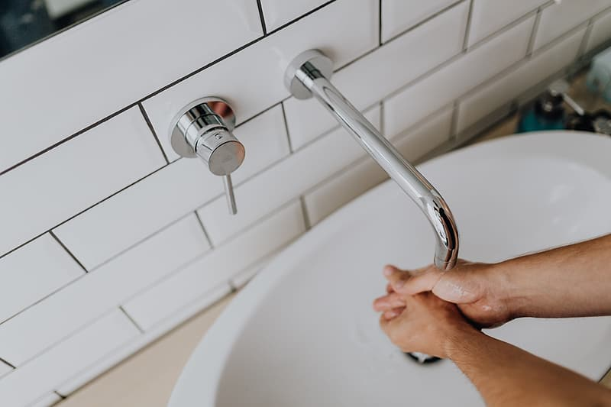
Water, A Complex Image
Think of two uses of water that make it necessary for human life:

Slide 12
Water, A Complex Image
As we will see, Jesus doesn’t call Himself “living water” as He does with “bread of life” (6:35) or “light of the world” (8:12).
Rather, Jesus identifies Himself as the giver of living water (4:10; cf. 7:39).
We will discover, as we read through the Gospel of John, what this “living water” is!

Slide 13
John 4:1–42
Giver of Living Water

Slide 14
What Often Happens between Men and Women at Wells in the Old Testament?
Isaac & Rebekah: Genesis 24
Jacob & Rachel: Genesis 29:1
Moses & Zipporah: Exodus 2: 16–22
Now we see Jesus and a Samaritan woman meeting at a well. Based on our conversation last week (“The Bridegroom”), why might it seem like a connection between the Samaritan woman and Jesus is forming?

Slide 15
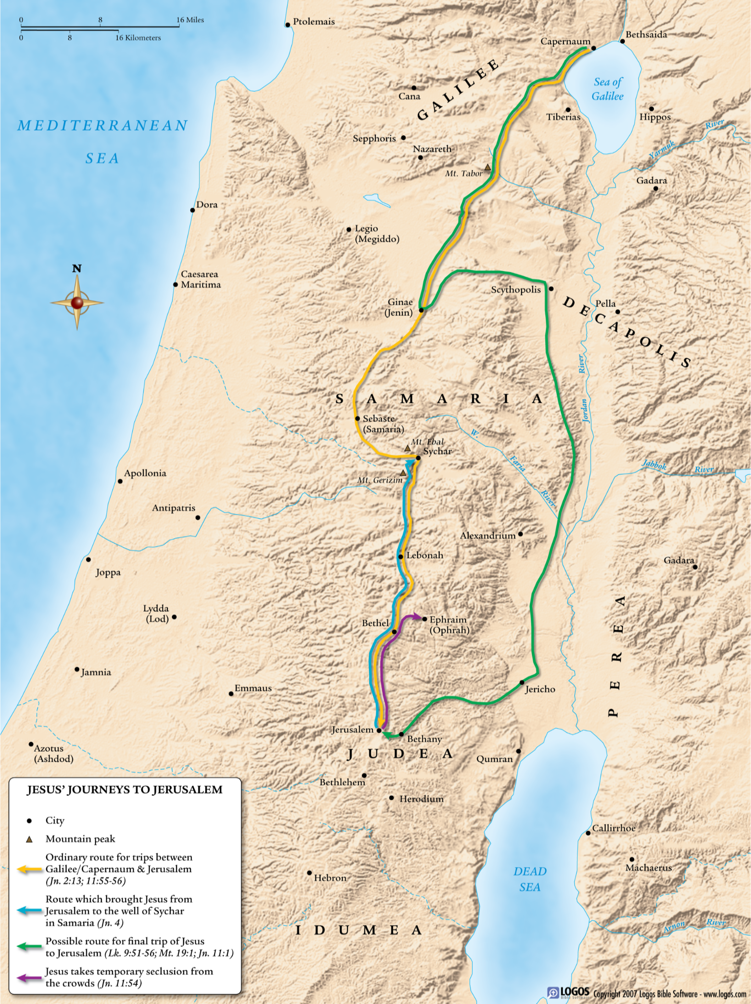
Jesus “must” pass through Samaria (4:4) and stops at Sychar

Slide 16
Brief Background on Samaria and the “Samaritans”
Samaritans and Jews both claimed Abraham and Jacob as their fathers/patriarchs
Who were/are the Samaritans? It depends on who you ask
Samaritan version
Old Testament version
Some Jews charged that Samaritans blended elements of Israel’s tradition with foreign gods and so revered “filth” on Mt. Gerizim (see 4:20–21)

Slide 18
Understanding “Living Water” (υδωρ ζων)
The Gospel of John frequently records Jesus’ use of double entendre, so it is likely the phrase would have conveyed…
“Fresh, running, or flowing water”…that is, the water in a stream or natural spring, rather than that supplied by a cistern
“Water of life” (Rev. 22:1, 17), which in the OT, pointed to God Himself (Jer. 2:13; 17:13)

Slide 19
Understanding “Living Water” (υδωρ ζων)
For drinking…“Fresh, running, or flowing water” from a stream or natural spring, would have been viewed as longer lasting, healthier, and more delicious than water supplied by a cistern
For washing… Only flowing water was considered appropriate for ritual cleansing in the Jewish tradition.
For one who must draw and carry water by hand… Why do you think the woman might have chuckled and said, perhaps a bit sarcastically, “Sir, give me this living water!”?

Slide 20
John 7:37–39
Giver of Living Water

Slide 21
Jesus at the Feast of Booths/Tabernacles (7:2, 37)
This was a festival that occurred at the end of the dry season and the beginning of the rainy season
It commemorated God’s protection of Israel during its wilderness wanderings (see Exod 17:1–6 )
In Jesus’ day a water libation ceremony would have accompanied the Feast, together with the reading of Isaiah 12:1–5; water brought from the Pool of Siloam and wine were poured over the altar of the Jerusalem temple.
What is the “living water” Jesus gives, according to Him?
Read Rev 22:1–5 (Psalm 1:1–3). Thoughts?

Slide 22
John 20:19–23
Giver of Living Water (the Holy Spirit)

Slide 23
The Spirit (Living Water) Gives Life
Let’s go back to the earlier image of the woman at the well. Consider the first sin of Adam and Eve and how the original blissful picture of work/play/rest intended by God became painful, with thorns and sweat (Gen 3:17–19).
At His resurrection, when Jesus breathes over His disciples giving them the gift of His Spirit, John uses the same word as was used to breathe into Adam, giving him the breath of life (Gen 2:7)!
What does this say to you about

Slide 24
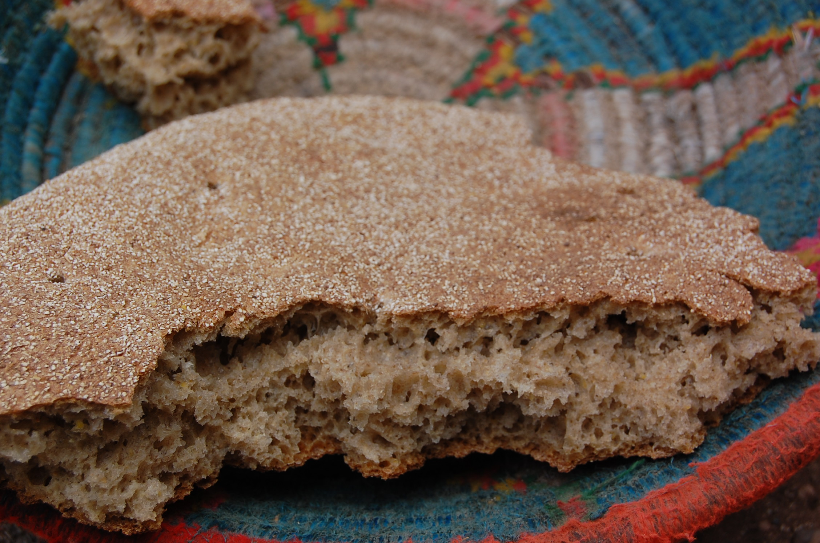
Bread of Life
For Next Sunday, Read John 6:22–35

