Slide 1
Session 5 Gospel of John Class February 9, 2020
Resurrection Lutheran Church, Cary
Jonathan A. Blanke, Ph.D.

Slide 2
How to Find Past Class Notes
Go to rlcary.org

Slide 3
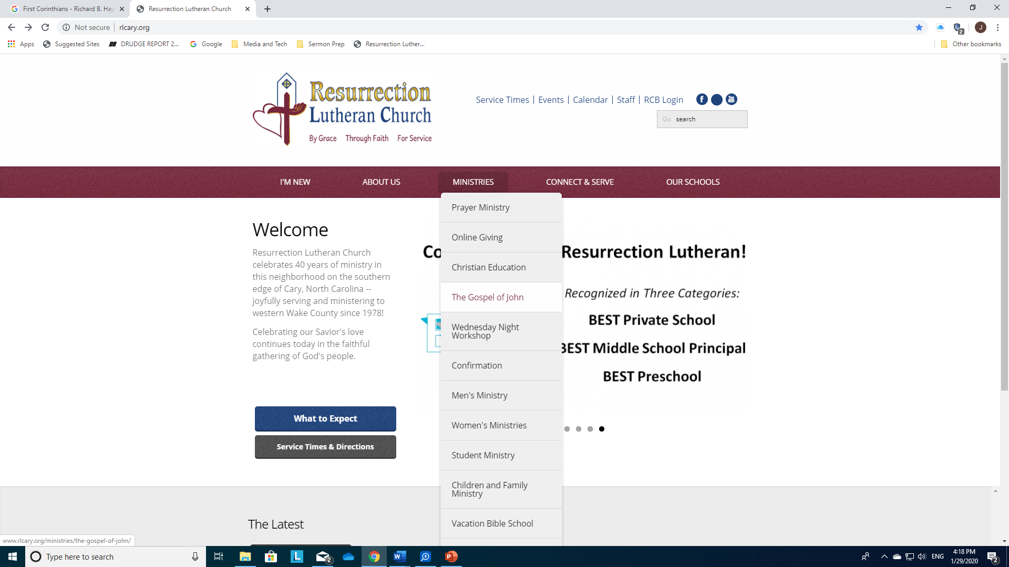

Slide 4
“Bread of Life”
Review
John 4:1–30 & 7:37–39

Slide 5
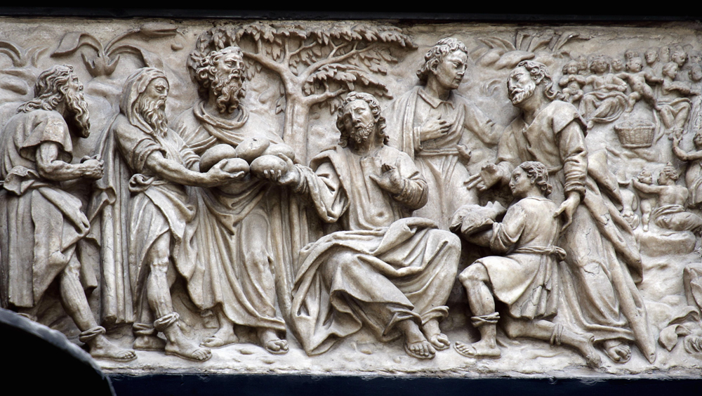
The bread of life image in John is associated with a “sign” containing bread

Slide 6
Understanding signs and symbolic actions
Allusions to Jesus’ death and resurrection appear in each of the symbolic actions, so that Jesus’ death and resurrection disclose the significance of earlier actions, and earlier actions help readers discern the meaning of Jesus’ suffering and death.
Conversations and discourses We will see what Jesus does here in light of His “bread of life discourse”
Actions appropriate and redefine associations with images connected with the action (in this case, eating “bread” until satisfied seems to indicate something imporant)

Slide 7
A New Moses?
“When the people saw the sign that [Jesus] had done, they said, ‘This is indeed the Prophet who is to come into the world.’ Perceiving then that they were about to come and take him by force to make him king, Jesus withdrew…” (6:14-15)
What is meant by “the Prophet”? See Deut 18:15–18.
Review what we learned about the motif of misunderstanding in John’s Gospel. What does such misunderstanding lead us to see about the crowd? About Jesus?

Slide 8
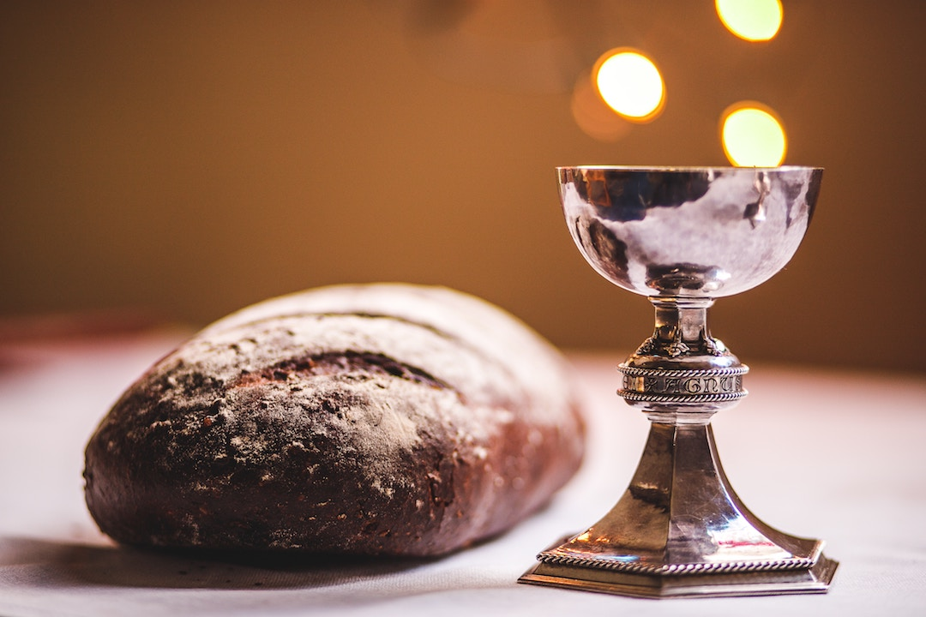
Do you believe Jesus is describing His Word as food….
When Jesus tells His listeners that unless they “eat [His] flesh and drink [His] blood” they have no life in them (6:53), what is He talking about?
Or is He talking about the blessing of Holy Communion?

Slide 9
Two Kinds of Bread/Two Kinds of Listeners
Interest is in food that perishes (6:27)
Interest is in making Jesus a king by force (6:15)
Focus on Moses as the “He” who gives bread (6:32)
Do not remain with Jesus, but fall away (6:60–66)
Interest is in food that endures (6:68)
Interest is in receiving Jesus (6:21)
Focus on the Father as the “He” who gives bread (6:32)
Remain with Jesus, for He has the words of eternal life (6:68)

Slide 10
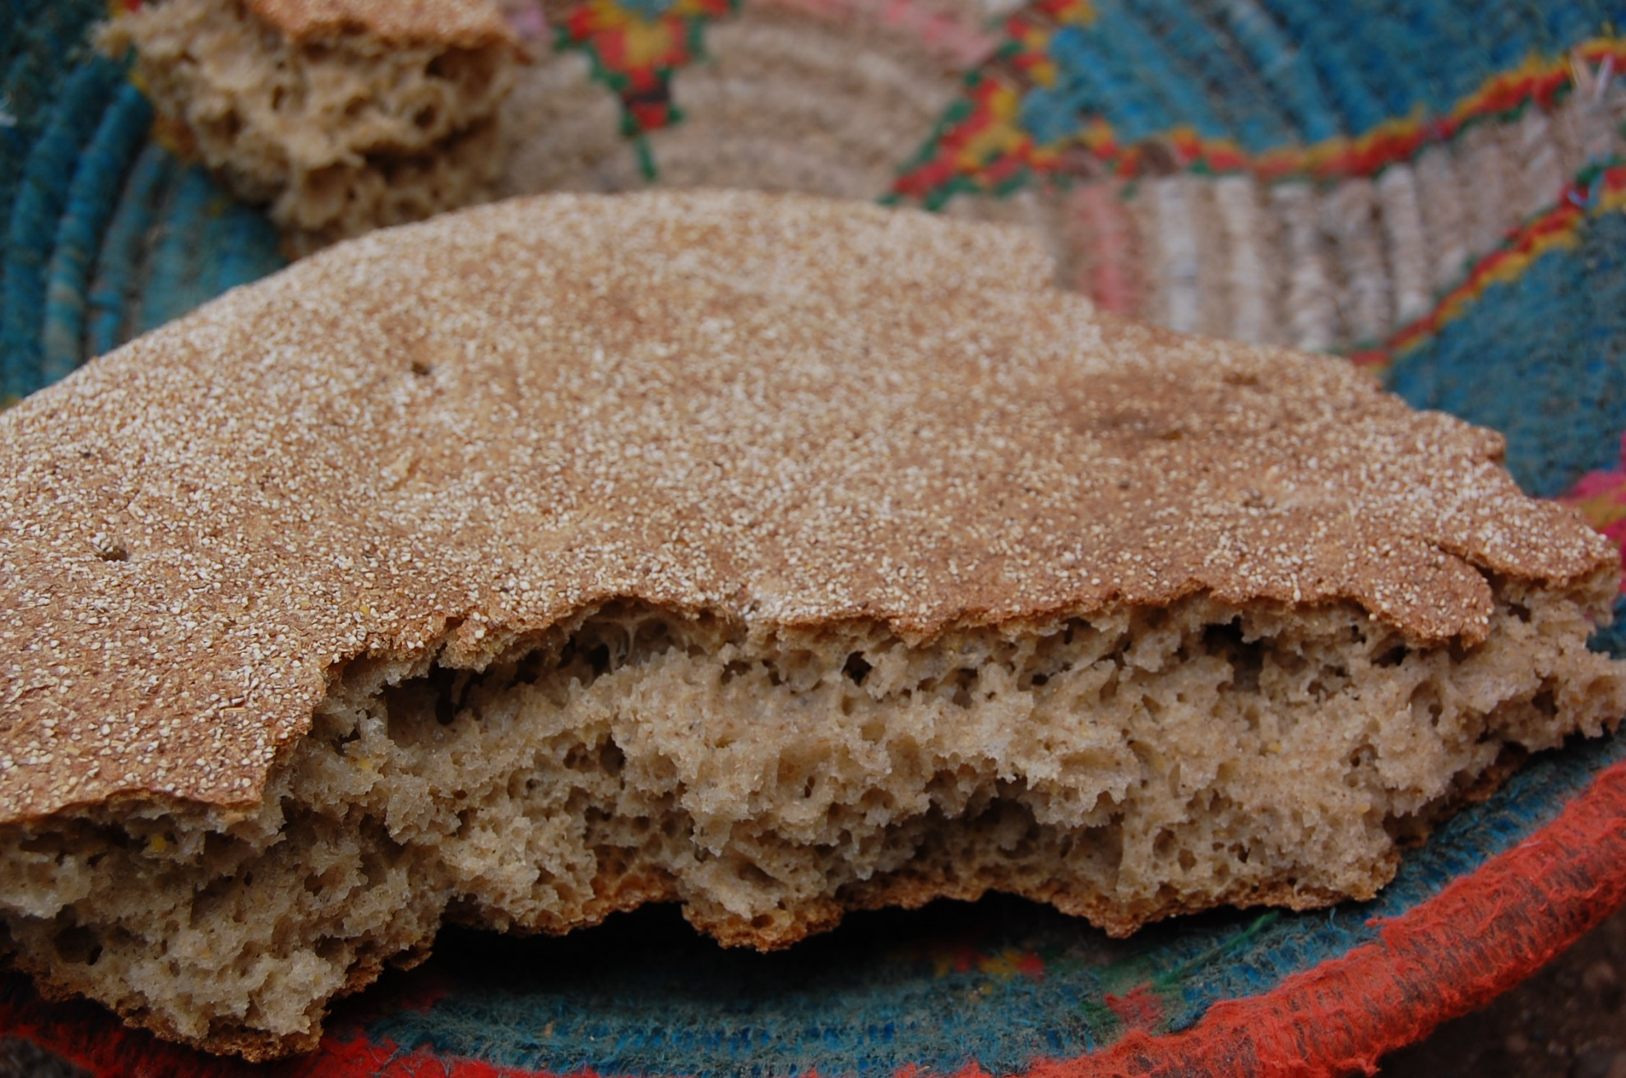
What “lesson” is there in these two kinds of bread and two kinds of listeners, for 21st century readers of John’s Gospel?

Slide 11
“Light of the World”
John 1:1 – 9; John 3:1–21; 8:12; 9:1–41 & John 3:1–21

Slide 12
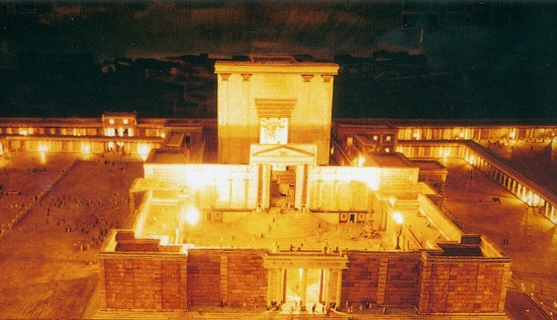
Feast of Tabernacles (Booths), Part 2
According to Jewish oral tradition, at the end of the first day of the Feast of Booths four tall candlesticks were set up in the Court of the Women inside the temple.
The top of each candlestick was reached by ladders.
The Mishnah states that when these wicks were lit, “there was not a courtyard in Jerusalem that did not reflect the light”

Slide 13
John 8:12–20
“I am the light of the world…Whoever follows me will have the light of life and never walk in darkness.”

Slide 14
Light & Darkness for Early Readers of John
In Greco-Roman world, the god Serapis was “light of all men” and Isis “light of all mortals” (Symbolism, 159); non-Jews would have discerned the divine connotations in Jesus’ words.
References to light in Israel’s story are many; the fiery pillar that led Israel by night may be especially important in the context of the Feast of Booths (Exod 13:21–22)
Jesus is not just one light among many; he claims to be “the light of the world”; his disciples will never walk in darkness but have “the light of life” (John 8:12)

Slide 15
Seeing the Light: A Sign Performed (9:1–41)
(Jesus says, a second time) “I am the light of the world” (9:5)

Slide 16
Seeing but “Blind”/Blind but “Seeing”: John’s Use of Situational & Dramatic Irony
Jesus’ opponents assume a man born blind is “steeped in sin” at birth (9:34)
Jesus’ opponents call him a sinner, for he healed on the Sabbath (9:24)
Jesus’ opponents scoff at the idea that they are blind and guilty of sin (9:40-41)
Jesus calls the man’s disability an opportunity for “God’s works to be revealed” (9:3)
The blind man given to see calls Jesus a man “from God” and “Lord” (9:33, 38)
The blind man admits he was blind, but now sees; Jesus draws out the miracle of faith in him (9:35, 37)

Slide 17
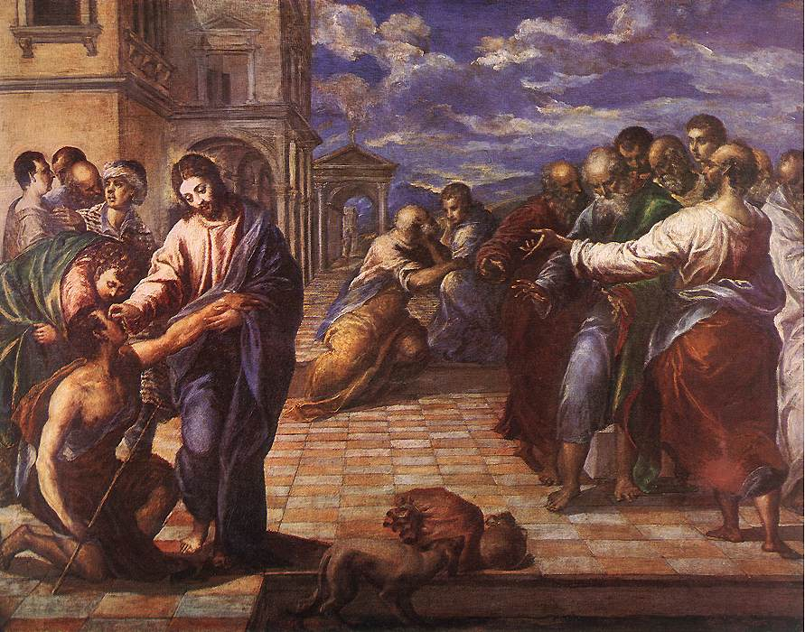
Understanding signs and symbolic actions
Allusions to Jesus’ death and resurrection: Compare this story with Jesus’ resurrection appearance to Thomas
Conversations and discourses: The contrast between Jesus’ seeing opponents (who think they understand him) and his believing followers (who are sure they do not yet understand him) is made unmistakably clear in John 8
Actions appropriate and redefine associations with images connected with the action (Is it significant that the man born blind is told to go and wash in the pool of Siloam? Why or why not?)

Slide 18
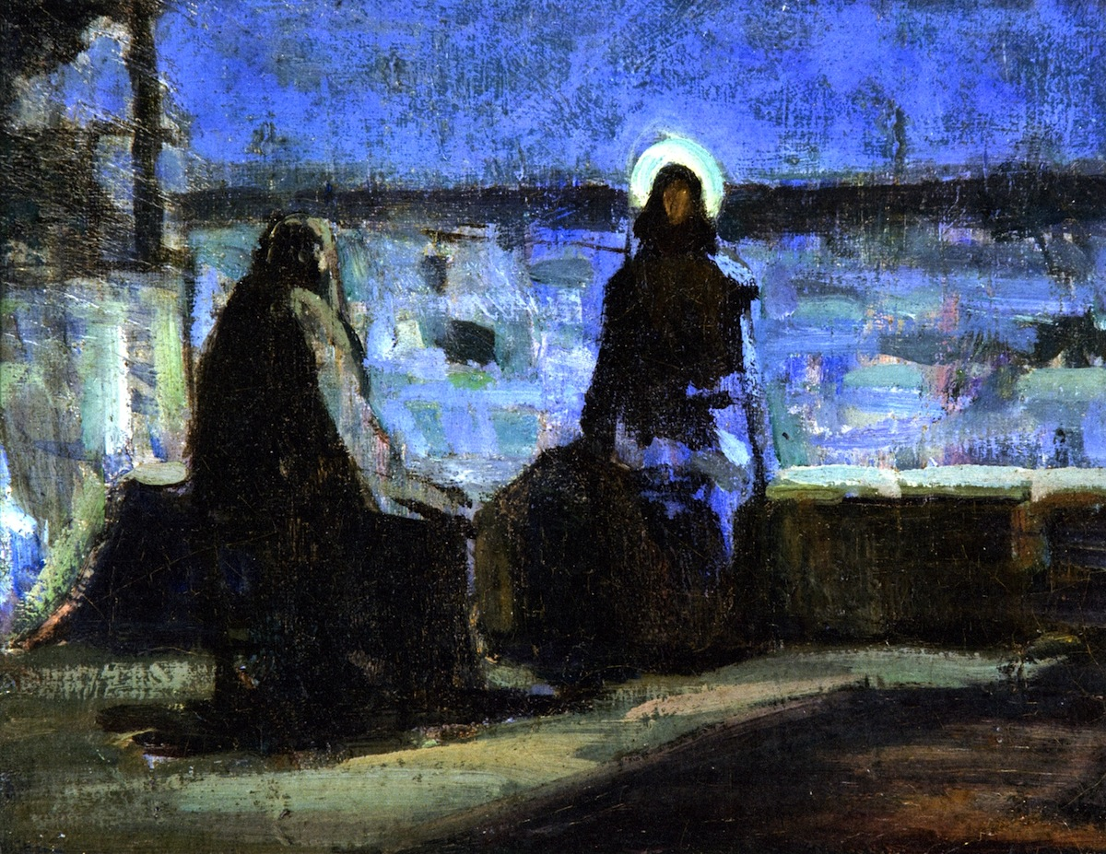
Nicodemus and Light/Dark
in the story of John’s Gospel

Slide 19
Light and Nicodemus, Part 1: 3:1–21
“[Nicodemus] came to Jesus by night” (3:2).

Slide 20
Light and Nicodemus, Part 2: (7:45–52)
“Nicodemus, who had gone to Jesus before, and who was one of them, asked… ” (3:2).

Slide 21
Light and Nicodemus, Part 3: (12:35–50)
“I have come as light into the world, so that everyone who believes in me should not remain in the darkness” (12:46).

Slide 22
Light and Nicodemus, Part 4: (19:38–42)
“Nicodemus, who had at first come to Jesus by night, also came…” (19:39).

Slide 23
Discuss
According to the Gospel of John, Nicodemus and Joseph of Arimathea hurried to prepare Jesus’ body for burial because “it was the Jewish Day of Preparation.” What do you think this means regarding the time of day and daylight?
Do you agree that Nicodemus came out of the darkness into the light of day, so to speak? Why do you say so?

Slide 24
Read John 11:10. On a physical level, Jews and Greeks in Jesus’ day believed that the eye emitted light rather than passively received light. (The person’s eye was believed to illuminate the person as the sun illuminated the earth.) Ability or inability to see depended not only on one’s circumstances, but on one’s internal condition: one’s belief or unbelief.
Assuming the Gospel of John presumes two kinds of “seeing,” how do you think these two kinds of seeing “work”?
Why is this important?

Slide 25
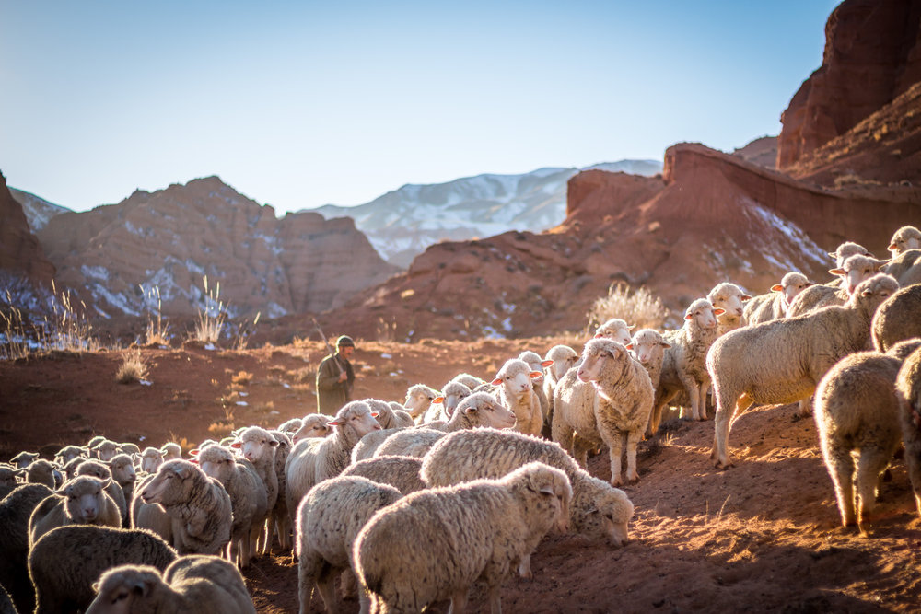
For Next Week Read John 10:1–39
The Good Shepherd

