Slide 1
Session 6 Gospel of John Class February 16, 2020
Resurrection Lutheran Church, Cary
Jonathan A. Blanke, Ph.D.

Slide 2
“Light of the World”
John 1:1 – 9; John 3:1–21; 8:12; 9:1–41

Slide 3
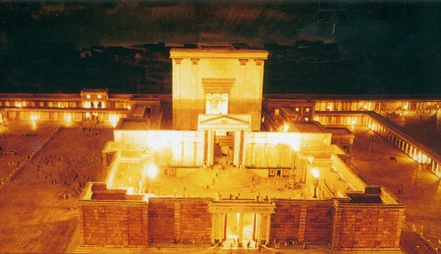
Feast of Tabernacles (Booths), Part 2
According to Jewish oral tradition, at the end of the first day of the Feast of Booths four tall candlesticks were set up in the Court of the Women inside the temple.
The top of each candlestick was reached by ladders.
The Mishnah states that when these wicks were lit, “there was not a courtyard in Jerusalem that did not reflect the light”

Slide 4
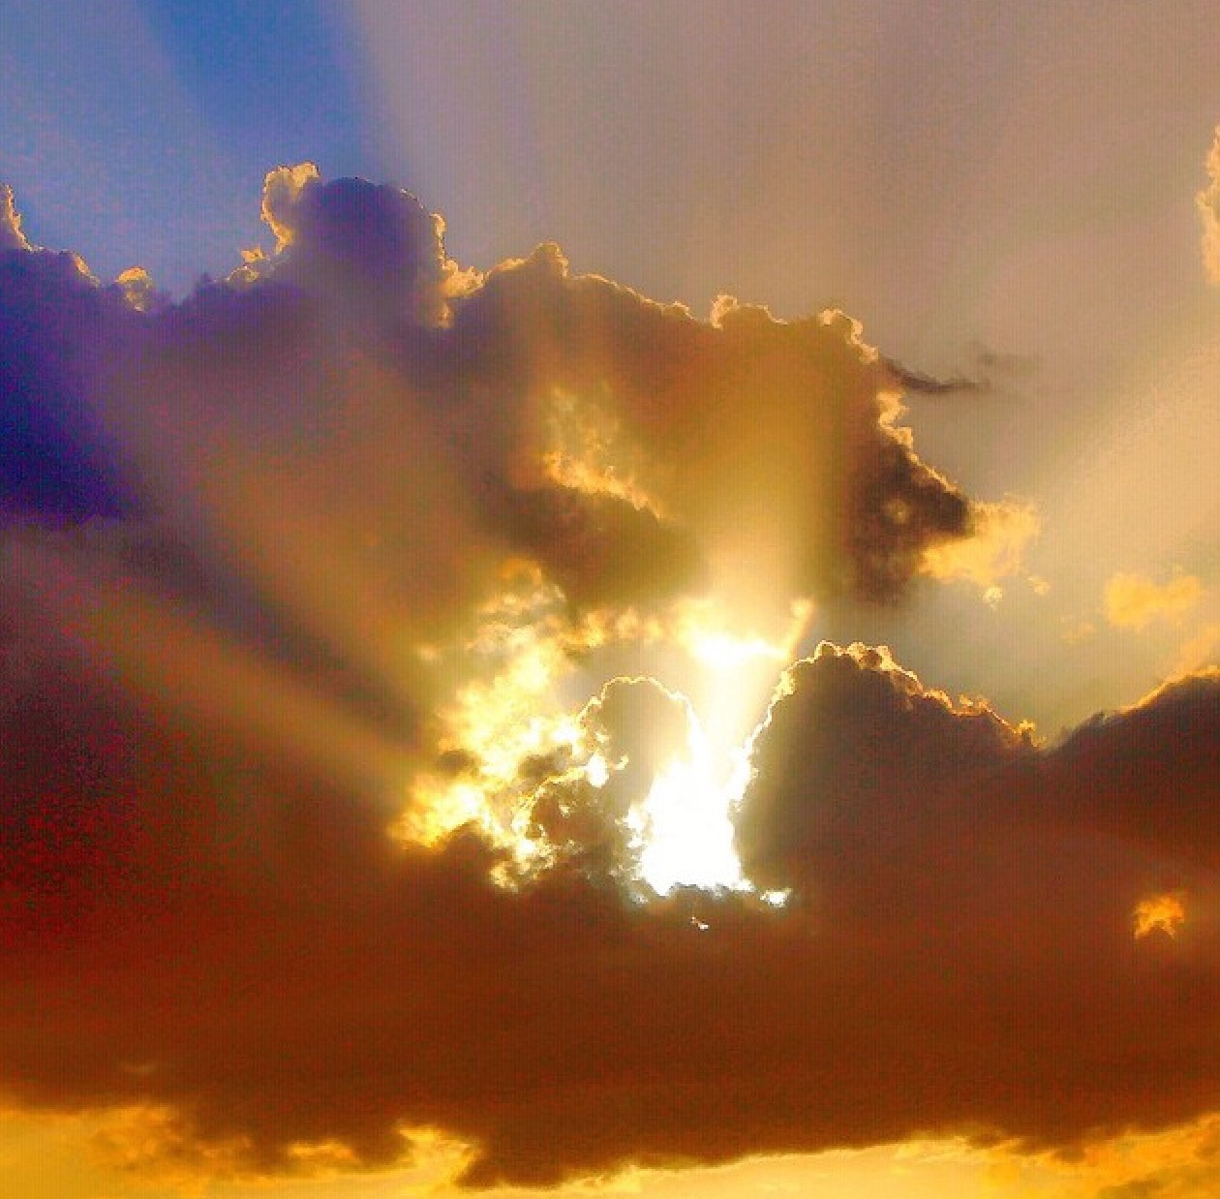
Light & Darkness for Early Readers of John
In Greco-Roman world, the god Serapis was “light of all men” and Isis “light of all mortals” (Symbolism, 159); non-Jews would have discerned the divine connotations in Jesus’ words.
References to light in Israel’s story are many; the fiery pillar that led Israel by night may be especially important in the context of the Feast of Booths (Exod 13:21–22)
Jesus is not just one light among many; he claims to be “the light of the world”; his disciples will never walk in darkness but have “the light of life” (John 8:12)

Slide 5
Seeing but “Blind”/Blind but “Seeing”: John’s Use of Situational & Dramatic Irony
Jesus’ opponents assume a man born blind is “steeped in sin” at birth (9:34)
Jesus’ opponents call him a sinner, for he healed on the Sabbath (9:24)
Jesus’ opponents scoff at the idea that they are blind and guilty of sin (9:40-41)
Jesus calls the man’s disability an opportunity for “God’s works to be revealed” (9:3)
The blind man given to see calls Jesus a man “from God” and “Lord” (9:33, 38)
The blind man admits he was blind, but now sees; Jesus draws out the miracle of faith in him (9:35, 37)

Slide 6
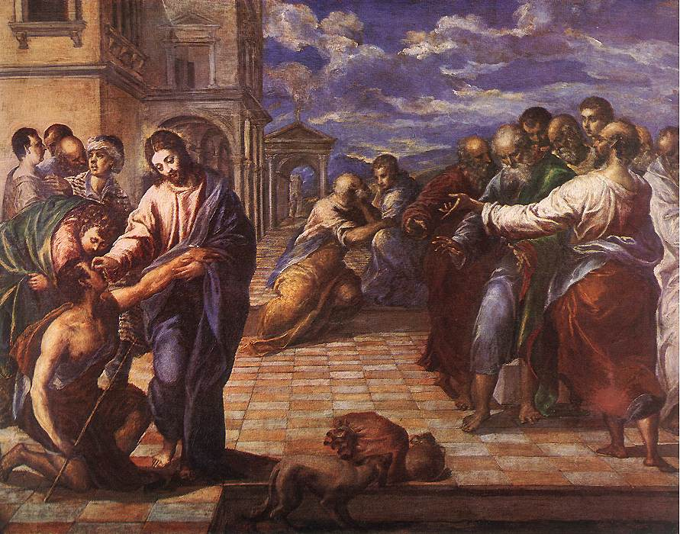
Understanding signs and symbolic actions
Allusions to Jesus’ death and resurrection: Compare this story with Jesus’ resurrection appearance to Thomas
Conversations and discourses: The contrast between Jesus’ seeing opponents (who think they understand him) and his believing followers (who are sure they do not yet understand him) is made unmistakably clear in John 8
Actions appropriate and redefine associations with images connected with the action (Is it significant that the man born blind is told to go and wash in the pool of Siloam? Why or why not?)

Slide 7
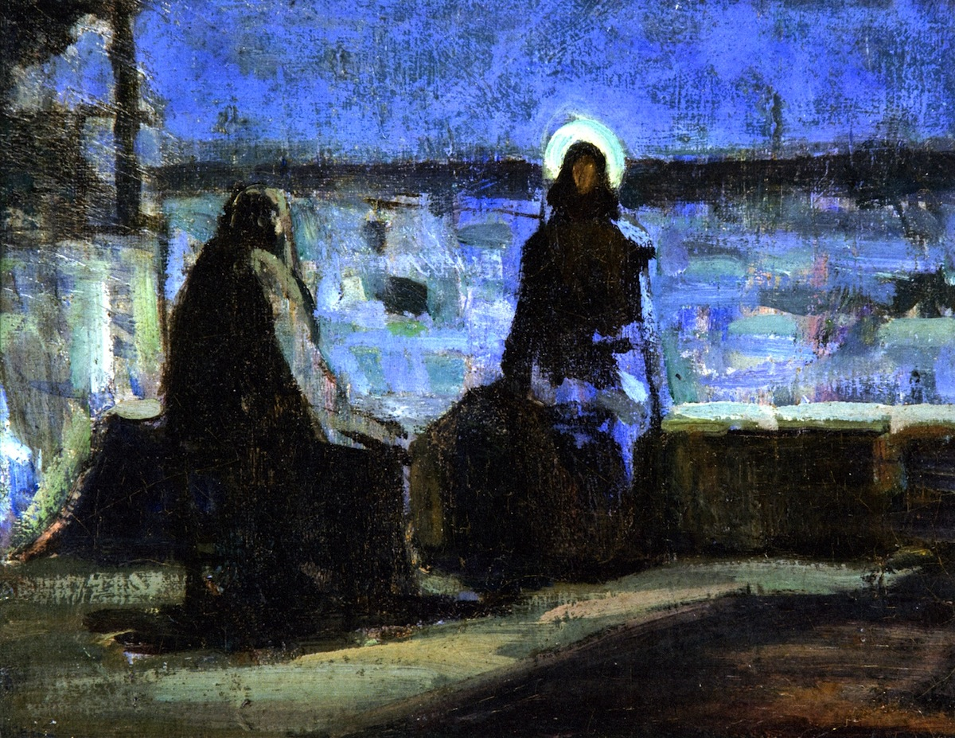
Nicodemus and Light/Dark
in the story of John’s Gospel

Slide 8
Discuss
According to the Gospel of John, Nicodemus and Joseph of Arimathea hurried to prepare Jesus’ body for burial because “it was the Jewish Day of Preparation.” What do you think this means regarding the time of day and daylight?
Do you agree that Nicodemus came out of the darkness into the light of day, so to speak? Why do you say so?

Slide 9
Read John 11:10. Jews and Greeks in Jesus’ day believed that the eye emitted light rather than passively received light. (the person’s eye was believed to illuminate the person as the sun illuminated the earth.) Ability or inability to see depended not only on one’s circumstances, but on one’s internal condition: one’s belief or unbelief.
Assuming the Gospel of John presumes two kinds of “seeing,” how do you think these two kinds of seeing “work”?
Why is this important?

Slide 10
“Good Shepherd”/ “King”
John 10–11; John 18:

Slide 11
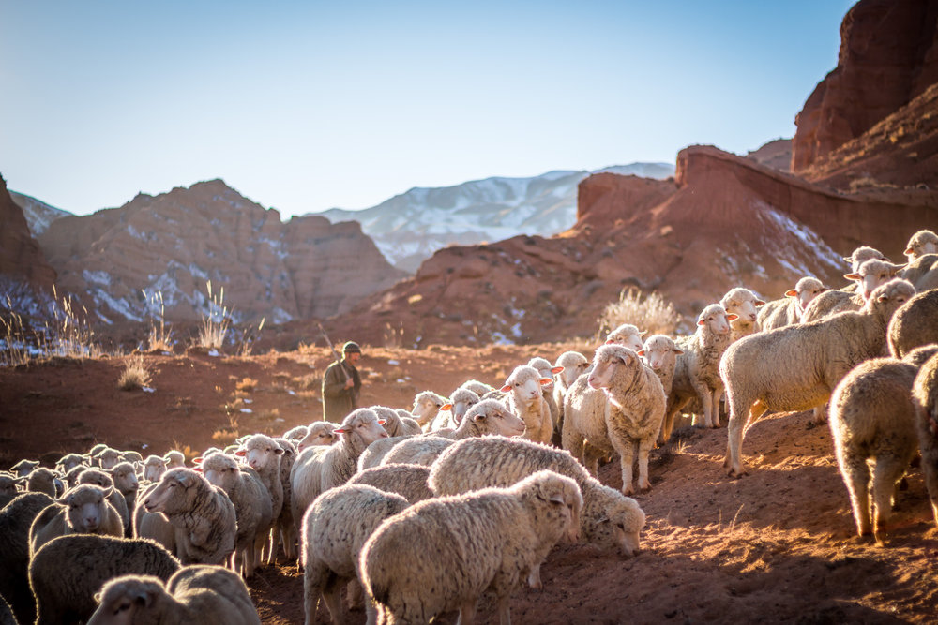
Understanding Shepherds in the Mediterranean World
The Good Shepherd (John 10)

Slide 12
Understanding the Image of “Shepherd”
General: Might have been, for some, a figure with weather-beaten face, dressed in course homespun clothing, with a wooden staff leading sheep or goats out to pasture
Greco-Roman world: Used as a metaphor for leaders like Agamemnon the king (Homer’s Iliad 2.243).
Jewish Scriptures: Important shepherds included leading figures in history: Moses (Ex 3:1-6) & David (1 Sam 17:34-35). Was used metaphorically of kings and even of “the Lord” God (Psalm 23)
General Image

Slide 13
Faithless Shepherds and Promise of “David” (Ezekiel 34:1–24)
The Good Shepherd (John 10)

Slide 14
The Expectation of a Shepherd/King
What sort of role do the “shepherds” of Ezekiel’s prophecy have?
How has their faithlessness to their shepherding role become manifest?
Who will become the “new” shepherd (34:11–16)?
What distinction is made between sheep under the
“new” shepherd (34:20–22)? What will he do?
Who is “my servant David”? Why do you imagine he is called a “prince” (34:24)?

Slide 15
Jn 10:1–39
The Good Shepherd

Slide 16
Understanding the Image of “Shepherd”
John 1o:
The Shepherd is the one who calls His sheep out by name (10:1–5)
Jesus identifies Himself as the Good Shepherd who lays down His life for His sheep (10:7-15, 17–18)
Jesus will gather “other sheep” not of this sheepfold (10:16)

Slide 17
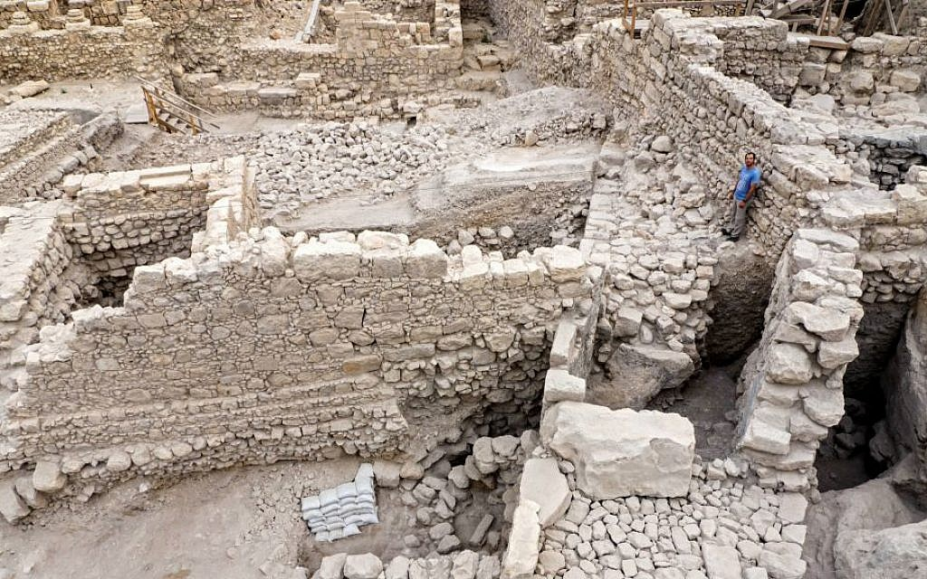
Feast of Dedication (τα εγκαινια): Jn 10:22-23
Remains of Acra, destroyed by Simon the Maccabee in 141 BC

Slide 18
Feast of Dedication (τα εγκαινια): Jn 10:22-23
Imbedded in the celebration of Dedication was the very issue of the Jewish people…a people who worshiped one God and were bound by Torah. This reality contained the possibility that another Antiochus might set up a “desolating sacrilege” again in their holy place or that one of their own would
blaspheme the Holy One of Israel and lead others astray. The Feast was an attempt to summon the people to faithfulness and say, “Never again!” At this feast Jesus speaks of Himself as “Shepherd”!

Slide 19
“The Good Shepherd” Jn 11:1–39
“From that day on, the authorities made plans to kill Jesus”

Slide 20
How is Jesus a “Good Shepherd” to Lazarus and all the sheep to be gathered through His death?
John 1o:
The Shepherd is the one who calls the sheep out by name (10:1–5)
Jesus identifies Himself as the Good Shepherd who lays down His life for His sheep (10:7-15, 17–18)
Jesus will gather “other sheep” not of this sheepfold (10:16)

Slide 21
Good Shepherd and King (John 18:17-19:22)
“The only King we have is the Emperor!”

Slide 22
A King on Trial: John 18:17 – 19:22
What do you notice in this scene regarding situational irony (events are contrary to our expectations) and dramatic irony (we know and recognize what people in the story do not)?
In the trial depicted in this scene, Jesus is pronounced guilty of insubordination against an earthly king, Tiberius Caesar. Based on what Jesus said earlier about his work as Good Shepherd, what other trial in the mind of the reader is also going on? How does the Gospel writer expect THAT trial will end (see 20:31)?

Slide 23
Under-Shepherd to the Good Shepherd (21:15 – 24)
“Take care of my sheep.”

Slide 24
Under-Shepherd to the Good Shepherd (21:15-24)
In what way do these final words of Jesus to Peter indicate Peter is still a sheep?
In what way is Peter now understood to be a shepherd?
Why do you think Jesus asked Peter three times if Peter loved Him?

Slide 25
Now that we have traced the implications of Jesus as Good Shepherd throughout this gospel, what does it mean for you that because of your Good Shepherd you now “have life” and “have it abundantly”(10:10)?

Slide 26
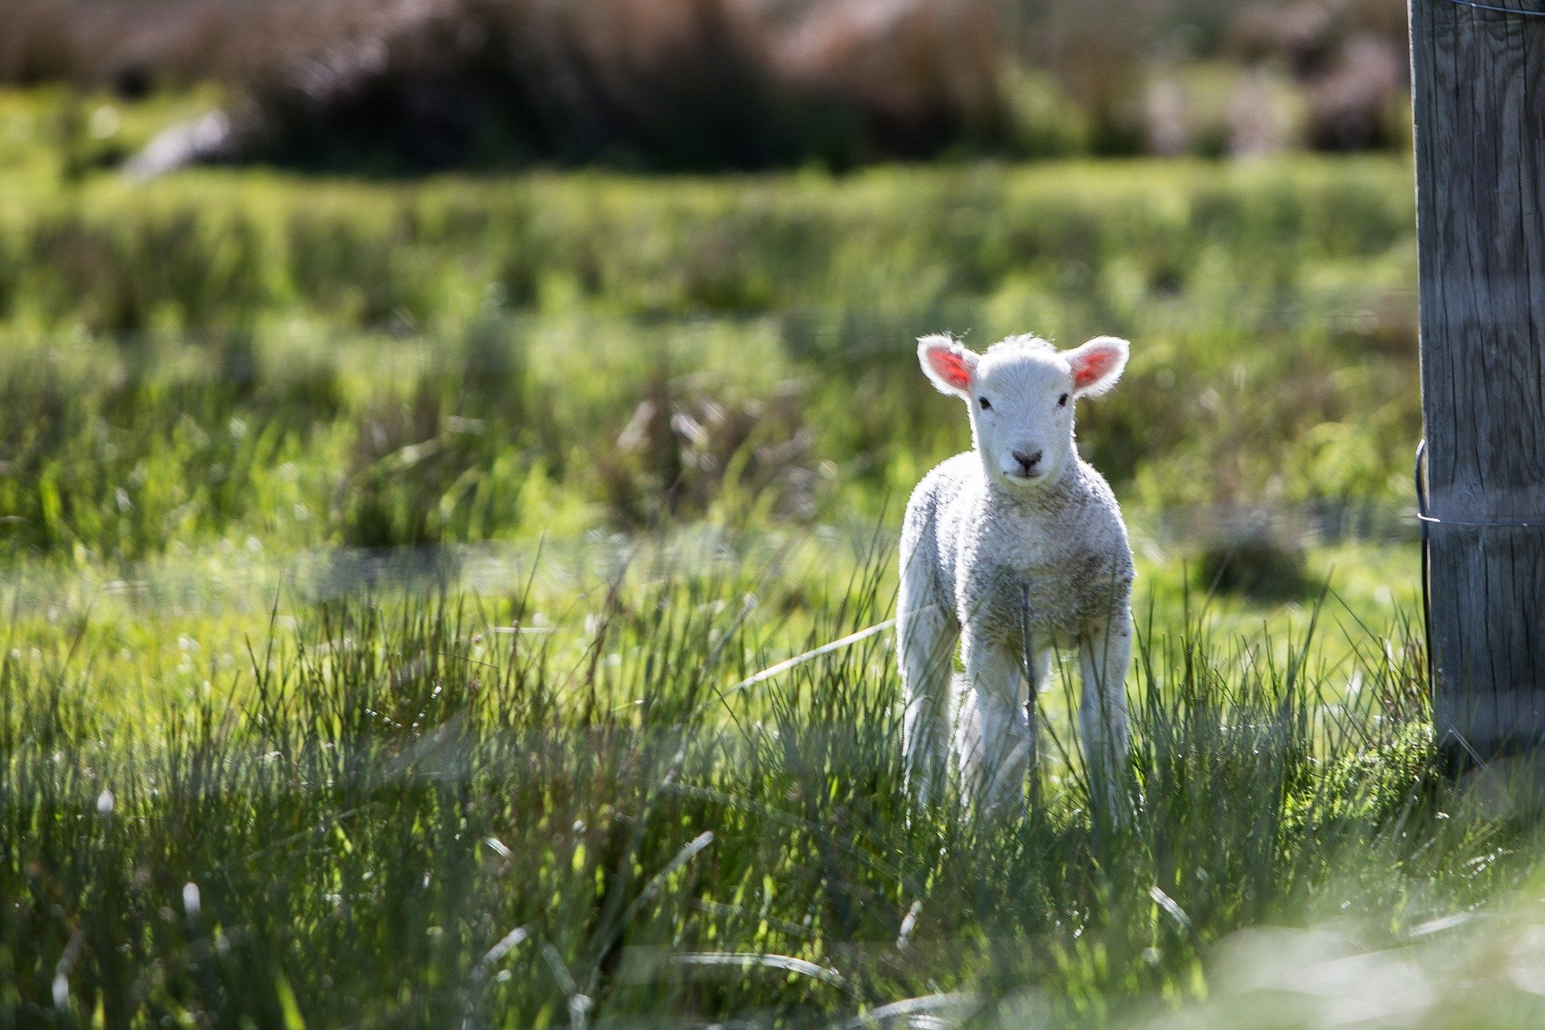
For next week, please read John 1:29, 2:13–22; 11:55–57; 13:1–30; 18:28–19:36; 21:1–14
Passover Lamb/Meal of Life

